Slide 1
HelloWorld.exe executions
Nov. 18th, 2023

Slide 2
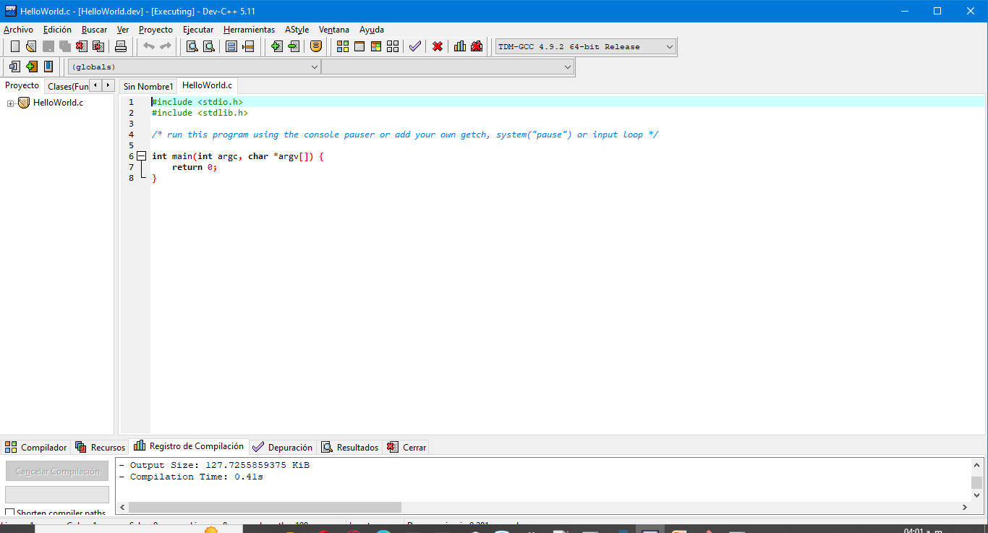
First HelloWorld.c code

Slide 3
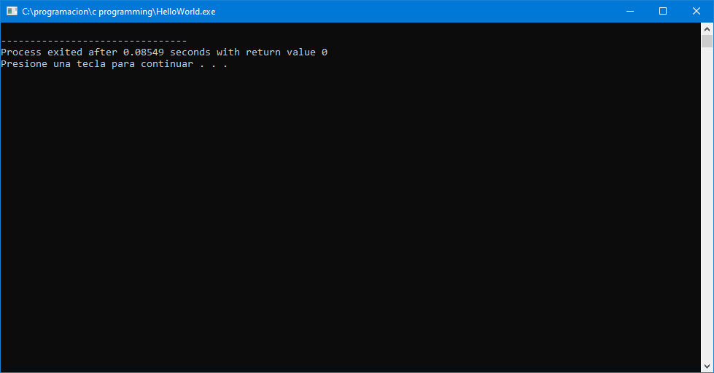
Execution

